Slide 1
PREDICTING THE
NBA DRAFT
Team Koolgle: Sid Karia, Kevin Moy, Joyce Li, John Um, and Jessica Wu

Slide 2
TABLE OF CONTENTS
01
02
03
04
OUR QUESTION
Based on college basketball statistics, can we predict which a person will be drafted in the NBA draft based on their college basketball statistics?
DATA COLLECTION
Where we got the data from and how we filtered/cleaned our data
DATA EXPLORATION
Position statistics, feature correlations with pick, dimensionality reduction, clustering
FINAL MODEL & CONCLUSION
Individual classifiers, ensemble methods

Slide 3
QUESTION
01
Based on college basketball statistics, can we predict where a person will be drafted in the NBA draft?

Slide 4
Our Question
We wanted to predict when a player would be drafted (lottery, first round, or second round) based on their college statistics.
We thought this project would be exciting since we can use the 2020 NBA draft that happened two weeks ago as our test set!

Slide 5
Motivation
Nobody has figured out the NBA draft, and there is no formula that can confidently measure how well a player will do in the NBA
Many experts create Draft Big Boards, a ranking of their top 60 draft prospects, but rarely are any of them accurate
We thought creating a model to tackle this would be difficult but fun
Useful for NBA scouts + teams, sports writers, NBA fans

Slide 6
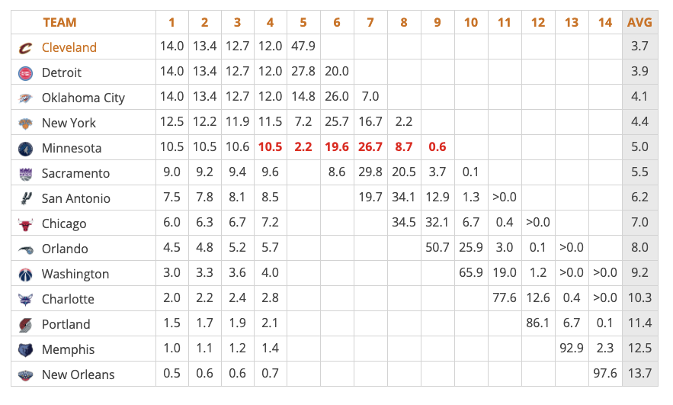
How the Draft Works
3 rounds: lottery + first round, second round
Lottery: The 14 teams that did not make the 2020 postseason (the playoffs) are eligible for the Lottery. This ensures that the team with the worst record will receive no worse than the fifth pick. Everybody has a shot to get the #1 pick which is why it’s called “Lottery”
Rest of First Round: The remaining teams are set in reverse order of how well they did in the regular season. The team with the best win-loss record has the 30th pick, second best has 29th…, sixteenth has the 15th pick.
Second Round: Set reverse order of how well teams did in the regular season.
Players are then selected by each team. Players can come from the NCAA, G-League, international basketball leagues, etc.
Players are evaluated based on their statistics (Points, Rebounds, Assists), their body measurements (height, weight, wingspan), and intangibles (work ethic, leadership), etc.
Source: https://www.nba.com/nba-draft-lottery-explainer

Slide 7
DATA COLLECTION
02
How we scraped, filtered, and cleaned our data

Slide 8
Dataset Schema
Each row represents a Player
32 features total
Pick Number (Response Variable)
Draft Year + College
Pre-draft physical measurables: Height, Weight, Draft Age
College/International/G-league per-game statistics (such as FG%, 3P%, MIN, AST, STL, etc.)

Slide 9
Data Collection Process
Coded a stat-scraper from Python BeautifulSoup library
Scraped college data off of basketball.realgm.com, for the last 10 drafts (2010-2019 NBA drafts)
Test Set: 2020 NBA draft
Challenges
Tables did NOT have distinguishing id attributes
An API for this should honestly already exist
Be the change in the world you want to see!
Lots of data cleaning!

Slide 10
Data Cleaning
Some players had to be manually filled in, because of absence of data from realgm source
Giannis Antetokounmpo did not play in college or any other international leagues
Players that simply had no available pre-draft stats at all (e.g. Darius Bazley): needed other sites for stats
Erroneous data

Slide 11
DATA EXPLORATION
03
Early data exploration, feature engineering, dimension reduction, clustering

Slide 12
Early Data Exploration
Positions:
Found that positions were important when looking at metrics such as average pick number per position and average stats per position
Pick Group
Decided it would be easier to divide picks into 3 groups:
Lottery (1-14)
Rest of First Round (15-30)
Second Round (30-60)
Prospects similar within pick group so decided to predict pick group and not number

Slide 13
Feature Engineering
Height:
Hypothesized that height was important in the NBA
Height by itself doesn’t tell us too much about the players, so created new feature
Pick Group Height Differential:
Decided to compare heights of players with the average of their pick group (lottery, first round, second round)
This feature wasn’t too strongly related to Pick by itself, so we decided to create a 2nd Height differential based on position

Slide 14
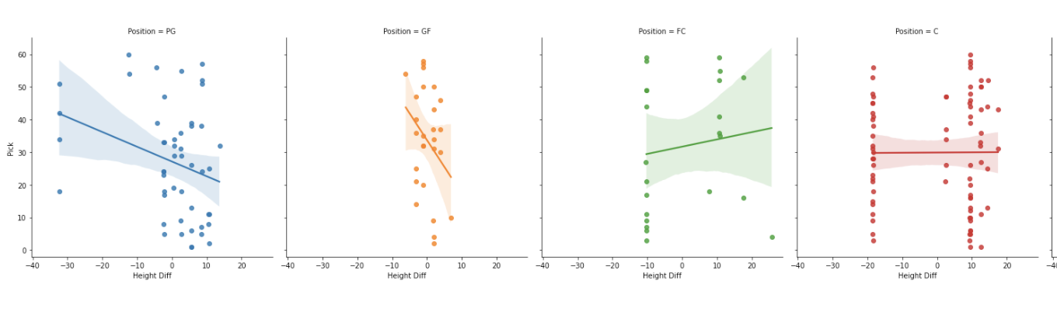
Feature Engineering
Positional Height Differential
Subtracted player height from average height in his position
This was meaningful because the height differentials had different effects on pick per position (see slopes)
Features We Wished We Could Add:
College Division/International
More statistics based on pick group/positions (PTS Diff)

Slide 15
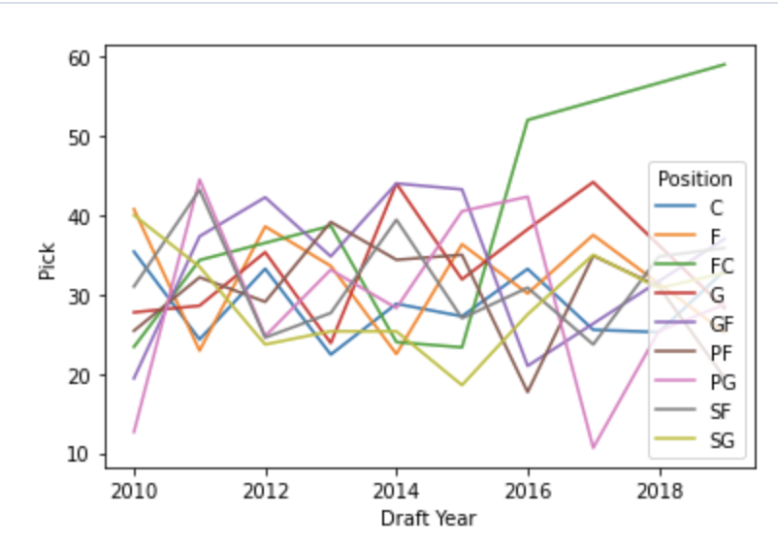
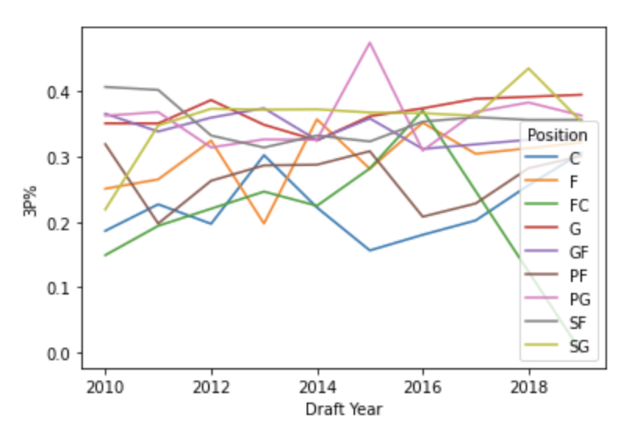
Changes Over Time
Dataset has information from 2010-2019, and knowing that the draft changes from year to year decided to see if we could find some trends over time
Lots of fluctuation over time for positional features
Pick position per position over 9 years
3P% per Position over 9 years

Slide 16
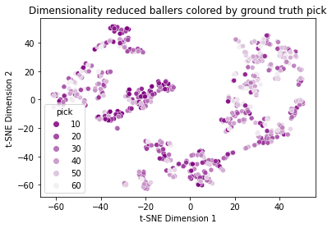
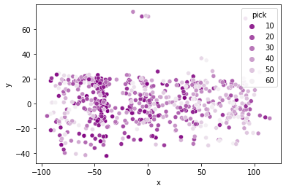
Dimension Reduction
2 methods used: t-SNE and PCA
Reduced high dimension vectors of player features (excluding pick) down to 2 dimensions to visualize and find any trends
Players to the left of the best picks are international, so technically should end there
t-SNE:
PCA:
Lots of clusters with player commonalities
No overall trend when visualized with any features other than ground truth pick (shown above)
Thus, hard to select most important features
Could cluster into groups, analyze feature spread
Clear trend when visualized with pick
PC1 (x) is linear combination of performance, highly correlated with pick number (could be useful as a model)
PC2 (y axis) is height, and somewhat weight + position
PC1 could be good linear regression for predicting pick

Slide 17
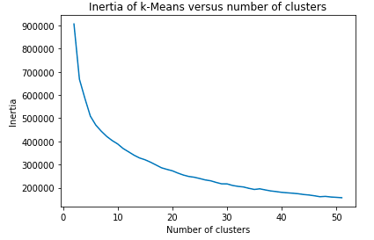
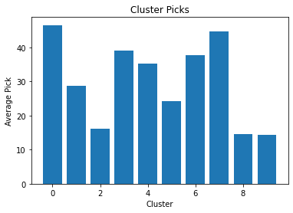
K-Means Clustering
Picked k clusters based on elbow method on distortions plot (k=10)
Ran k-means clustering and looked at averages for each feature to interpret clusters
Ended up not as less insightful as PCA Clustering because clusters were less defined
Cluster Interpretations and Other Trends Found:
The younger you are, the higher chance of getting picked in earlier rounds
Cluster 1,3,7 have the top GP and GS averages even though these clusters weren’t mainly top pick players
Clusters 2,5,8,9 had top pick players
When comparing cluster 2,5,8,9 stat averages compared to the average cluster, there weren’t any significant features that made it clear how they captured the top pick players
Player Position Distribution in Each Cluster Breakdowns
Cluster 0 was evenly distributed across roles
Cluster 1 was mainly guards and shooting guards
Cluster 2,4 was mainly point forwards
Cluster 3,5 was mainly forwards
Cluster 6 was mainly centers and point forwards
Cluster 7 was mainly shooting forwards
Cluster 8 was mainly shooting guards and point guards
Cluster 9 was mainly centers and point forwards

Slide 18
MODEL & RESULTS
04
Models we tested, final results on NBA draft test set, and conclusion

Slide 19
Features Used
Out of 32 original features, we used 19 such as Position, FGM, 3PM, Height Diff, Height Diff Pick Group, etc.
Took out certain features if they were directly calculated from others
Ex: FT% = FTA/FTM, so took out FT%
Other features taken out were ones that we could not use
Ex: Colleges
Looked at feature importance in models through eli5 sklearn Permutation Importance
Notes:
Final Features used: ‘Position', 'Draft Weight','Draft Age', 'GP', 'MIN', 'FGM', 'FGA', '3PM', 'FTM', 'OFF', 'DEF', 'AST', 'STL', 'BLK', 'PF', 'TOV', 'PTS', 'Height Diff Pick Group','Height Diff'

Slide 20
Modelling Approach
Split Data into Training and Test set
Because of the nature of NBA draft, we set the test set to the year we wanted to predict the draft of (i.e. 2020) and training set to the data from all other years (i.e. 2010-2019)
Tried different individual models with sklearn library
Decision Trees
Random Forests
Linear Support Vectors
Neural Networks
Also tried simple ensemble models
Bagging
AdaBoost

Slide 21
Final Model
Used Simple Combination Ensemble ( sklearn Voting Classifier)
Depending on test set (year of draft) and different results from individual classifiers, added well-performing models to ensemble
This included any models from simple decision tree to adaboost ensemble classifier
Used a hard majority vote to determine prediction

Slide 22
Model Results
41.7%
83.3%
74.1%
72.9%
71.7%
Test Accuracy on Pick Group Prediction of 2020 NBA Draft
Test Accuracy on 2019 NBA Draft (trained on 2010-2018)
Test Accuracy on 2018 NBA Draft (trained on 2010-2017, 2019)
Test Accuracy on 2011 NBA Draft (trained on 2010, 2012-2019)
Test Accuracy on 2010 NBA Draft (trained on 2011-2019)

Slide 23
Analysis
2020 Draft was an outlier; people considered the draft to be weaker this year than in the last few years
Not many potential “stars” in the draft
People who were drafted in 1st round this year might have been drafted in 2nd round previous years due to weaker NBA performance

Slide 24
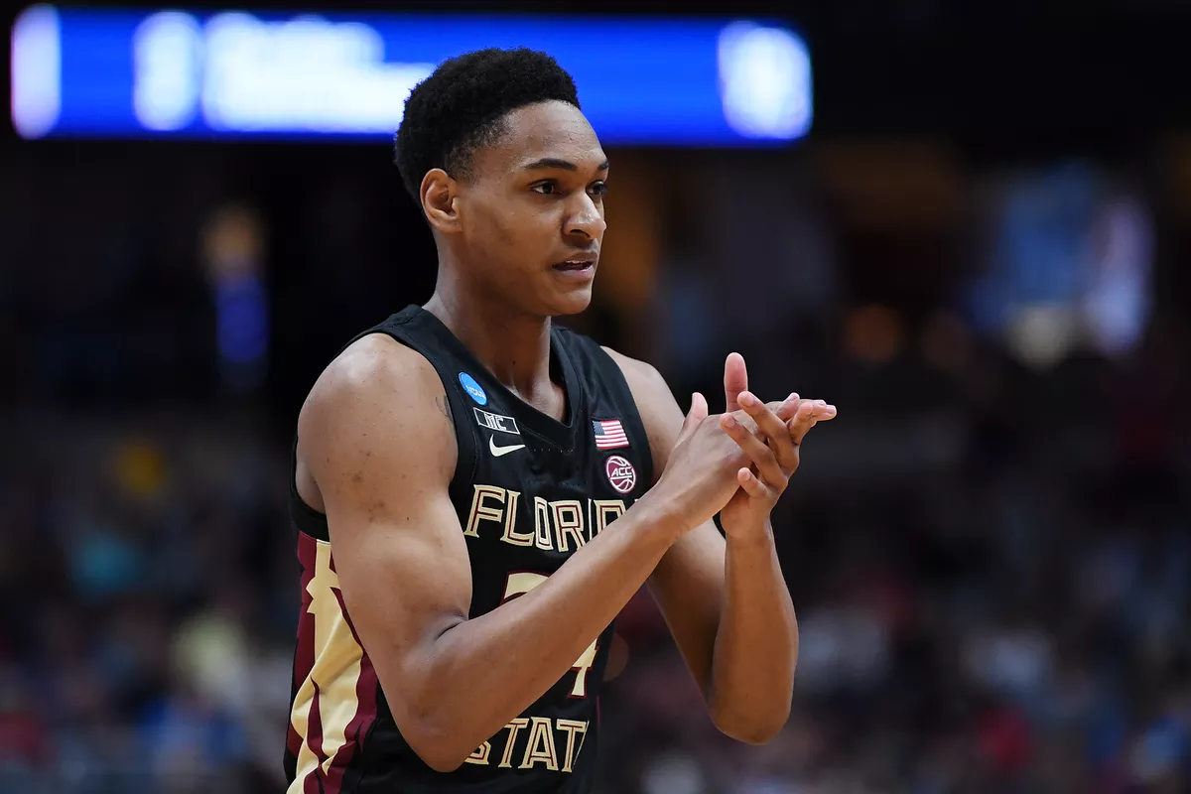
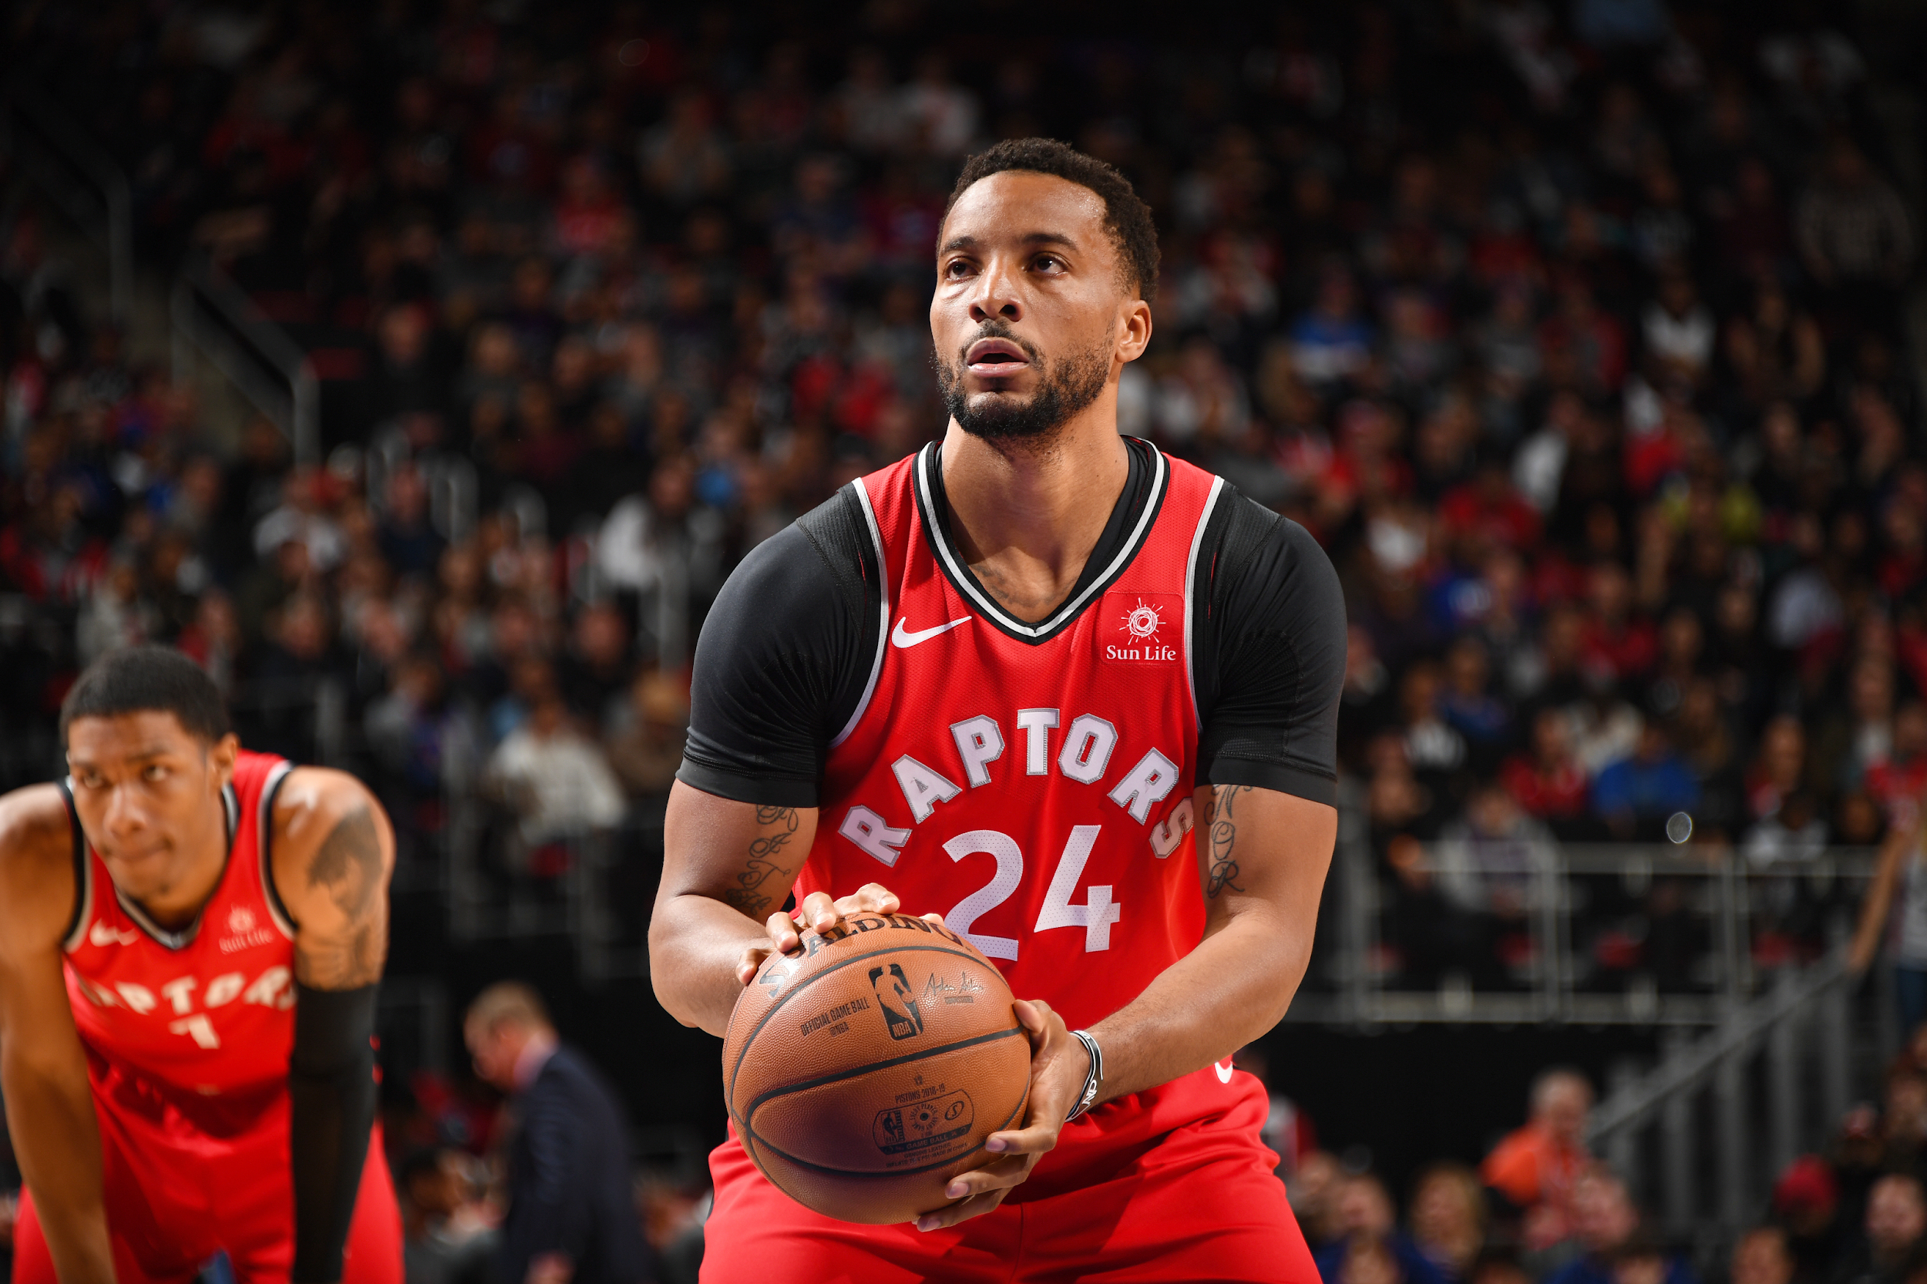
2020 Outlier Example
Devin Vassell: 2020 Round 1 Pick 11
Norman Powell: 2015 Round 2 Pick 46
asdf
PTS | TRB | AST | STL | BLK
8.4 | 3.22 | 1.11 | 0.95 | 0.62
PTS | TRB | AST | STL | BLK
9.76 | 3.01 | 1.5 | 1.12 | 0.4

Slide 25
Conclusion + Things to Improve
Model is solid, but could improve
Not ready for real world use yet, but good start!
Increase # of meaningful features
Advanced statistics, more measurements, etc.
Colleges! (Arbitrary numerical ranking?)
Qualitative Features such as leadership, attitude, etc.
Increase size of dataset
Try to incorporate NBA trends
Predict exact pick number instead of pick group
Notes:
not good enough for real world use bc its not specific enough and too variable between years

Slide 26
Questions?

Slide 27
Appendix: Stats
Name: Player’s Name
Pick: What number pick a player was selected with
Draft Year: What year they were drafted in
Draft Height: How tall they were when they were drafted (cm)
Draft Weight: How tall they were when they were drafted (kg)
Draft Age: How old they were when they were drafted
College: What college they went to
GP: Number of games played
GS: Number of games started
Min: Number of minutes played
FGM: Field goals made per game
FG%: Field goal percentage
3PM: 3 pointers made per game
3PA: 3 pointers attempted per game
3P%: 3 Pointers make percentage
FTM: Free Throws made per game
FTA: Free Throws attempted per game
FT%: Free Throw smake percentage
OFF: Offensive Rebounds per game
DEF: Defensive Rebounds per game
TRB: Total Rebounds per game
AST: Assists per game
STL: Steals per game
BLK: Blocks per game
PF: Personal Fouls per game
TOV: Turnovers per game
PTS: Points per game

